Slide 1
1

Slide 2




COMPARATIVE STUDY ON QUANTIZED AND NON-QUANTIZED MULTI-AGENT LLMS
PARTHA BP
DATE: 29/4/2025
6G INNOVATION LAB , CDOT
GUIDED BY : 1)KOWSIK N D
2)ANAND M
2

Slide 3
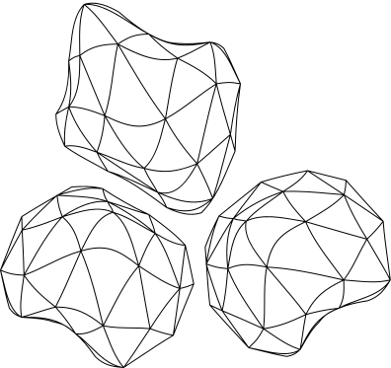

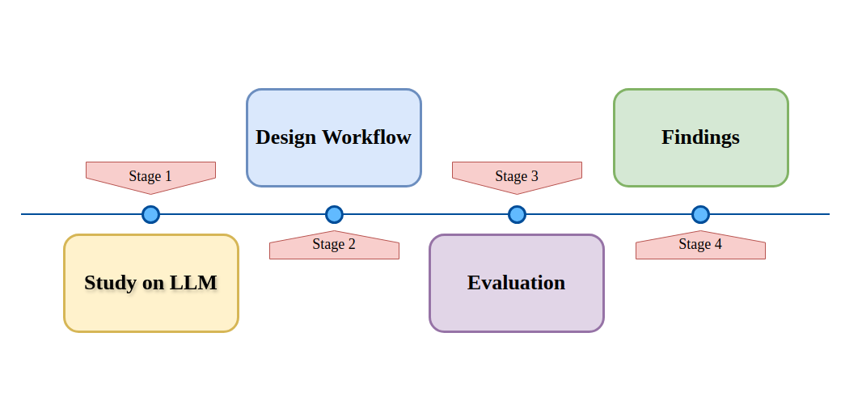
PROGRESS SO FAR
What is done till now ?
3

Slide 4
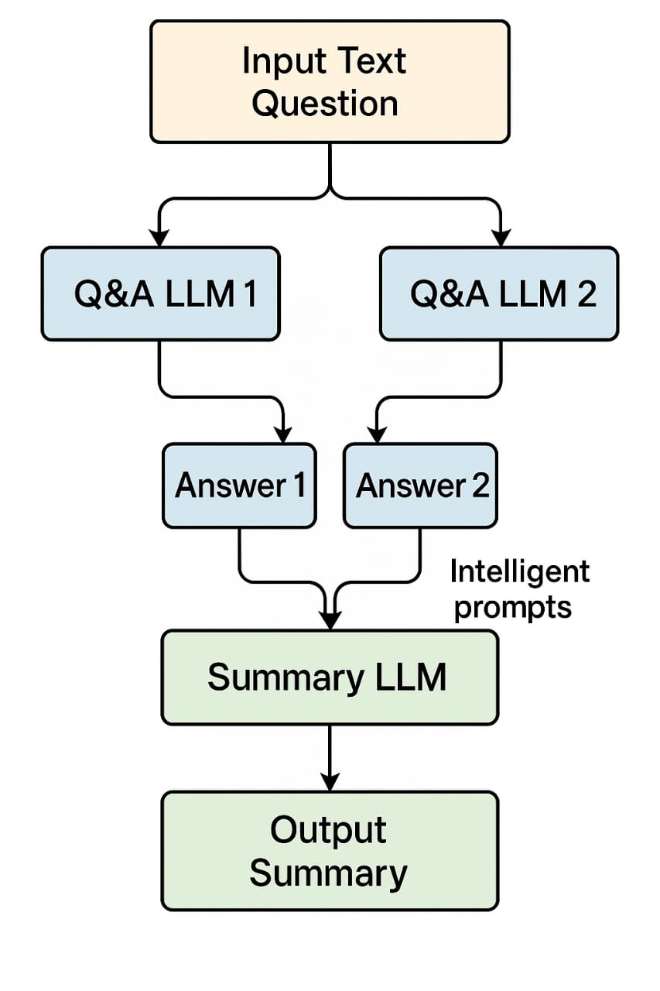

METHODOLOGY
Understanding the Evaluation Setup
Who discovered gravity?
4

Slide 5
5

Slide 6
METHODOLOGY
Understanding the Evaluation Setup
Sir Isaac Newton discovered gravity when he observed an apple falling from a tree and began to think about the force pulling objects toward the Earth.
While the concept of gravity existed earlier, Isaac Newton formulated the law of universal gravitation in the 17th century, mathematically describing the gravitational force between objects.
6

Slide 7
METHODOLOGY
Understanding the Evaluation Setup
Isaac Newton is credited with discovering gravity by formulating the law of universal gravitation after observing objects falling to Earth, such as an apple. His work provided a scientific explanation for the force that attracts objects toward one another.
7

Slide 8
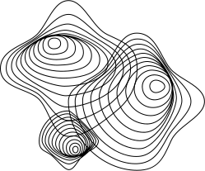
METHODOLOGY
Understanding the Evaluation Setup
"You are an expert AI assistant. Combine the best information from the two responses below into one clear, informative answer. "
"The final answer should be at least 50 words long, avoid vague phrases, and include factual terms or named entities "
"that improve keyword overlap with the reference answer if available.\n\n"
f"Response 1:\n{ans1}\n\n"
f"Response 2:\n{ans2}\n\n"
f"Reference (optional):\n{reference if reference else 'N/A'}\n\n"
"Final refined response:"

Slide 9
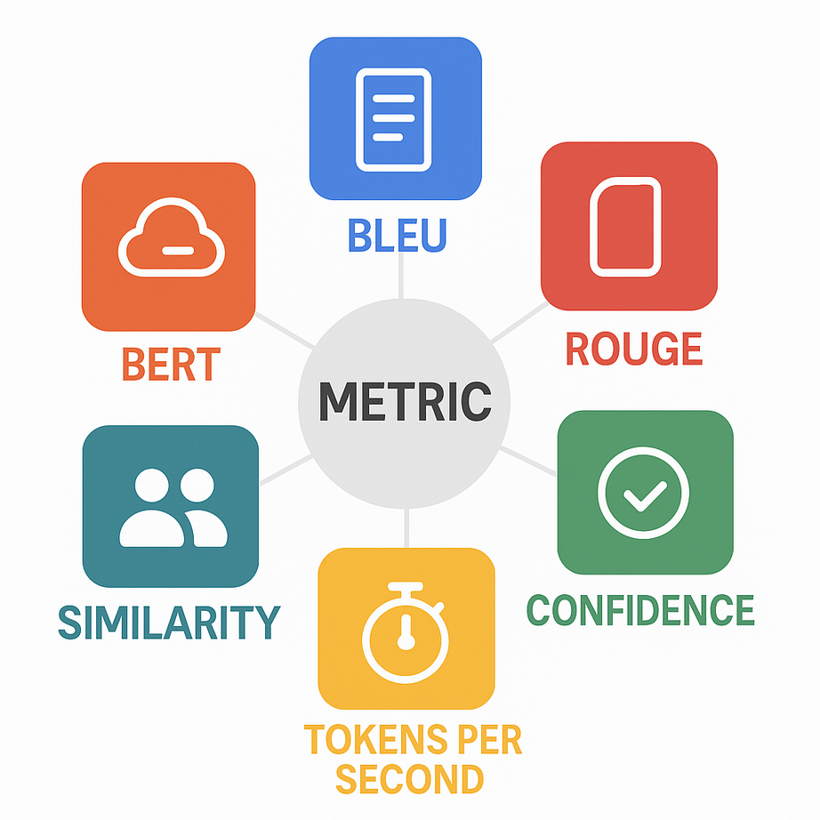
METHODOLOGY
Metric Differences
8

Slide 10


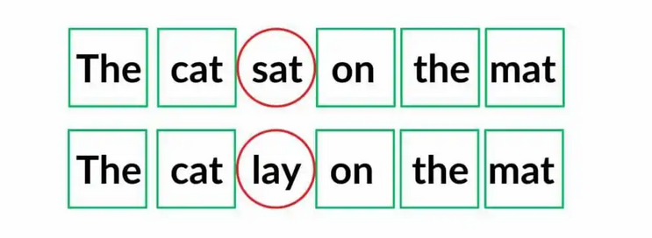
METHODOLOGY
Metric Differences
9

Slide 11
METHODOLOGY
Metric Differences
Matched unigrams: [”The”, “cat”, “on”, “the”, “mat"] → 5/6 = 0.83
10

Slide 12

METHODOLOGY
Metric Differences
ROUGE 1: [”The”, “cat”, “on”, “the”, “mat”] → 5/6 = 0.83
11

Slide 13
METHODOLOGY
Metric Differences
[“The cat,” “cat sat,” “sat on,” “on the” , “the mat”]
[“The cat,” “cat lay,” “lay on,” “on the” , “the mat”]
12

Slide 14
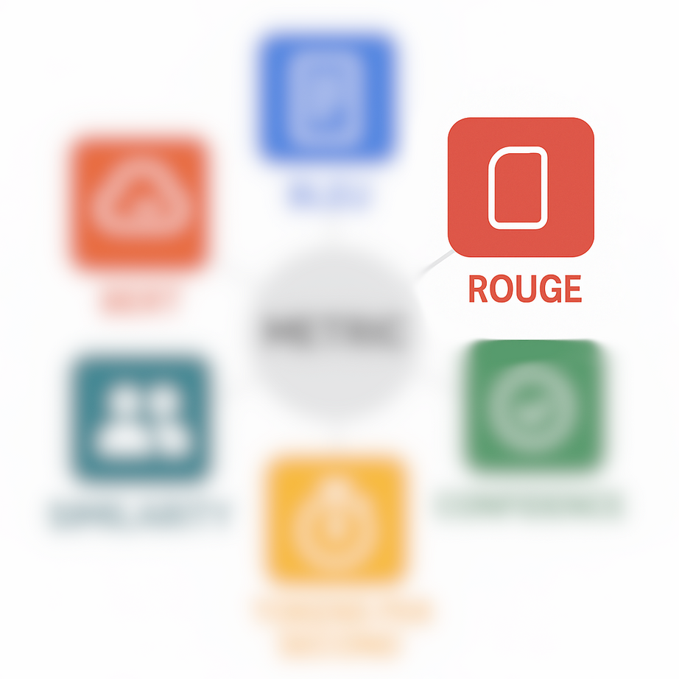
METHODOLOGY
Metric Differences
[“The cat,” “cat sat,” “sat on,” “on the” , “the mat”]
[“The cat,” “cat lay,” “lay on,” “on the” , “the mat”]
ROUGE 2: [“The cat”, “on the” , “the mat” ]→ 3/5 = 0.6
13

Slide 15

METHODOLOGY
Metric Differences
[“The ,” “cat ,” “sat“ , ”on,” “the” , “ mat”]
[“The ,” “cat ,” “lay“ , ”on” , “the” , “ mat”]
ROUGE L: [“The” , ”cat”, “on”, “ the” , “ mat” ]→ 5/6 = 0.833
14

Slide 16
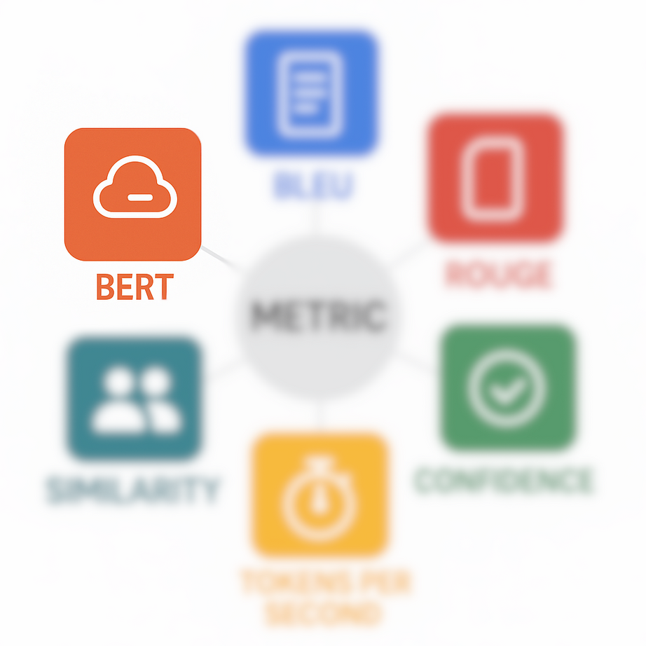
METHODOLOGY
Metric Differences
[“The ,” “cat ,” “sat ,” “on ” , “the ”, “mat”]
[“The ,” “cat ”, ”lay” , “ on,” “the” , “ mat”]
BERT: [“lay on”, “sat on ” ]→ same semantic meaning = 0.933
15

Slide 17

FINDINGS
16

Slide 18

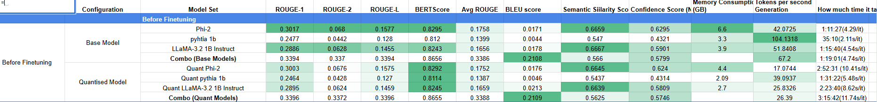
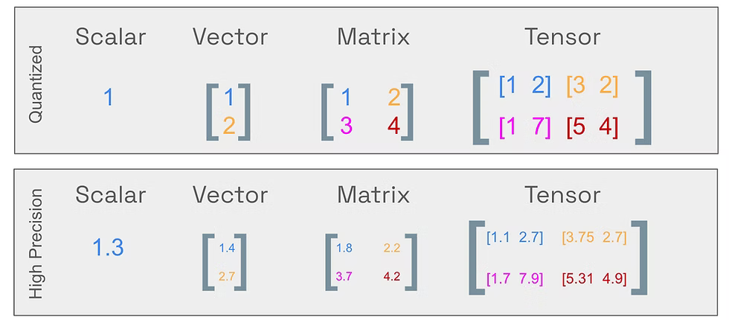
FINDINGS
FP32 : full precision (4 bytes), BF16 , FP16 : half-precision (2 bytes)
17

Slide 19
FINDINGS
BF16 , FP16 to Int8 (1 Byte)
18

Slide 20
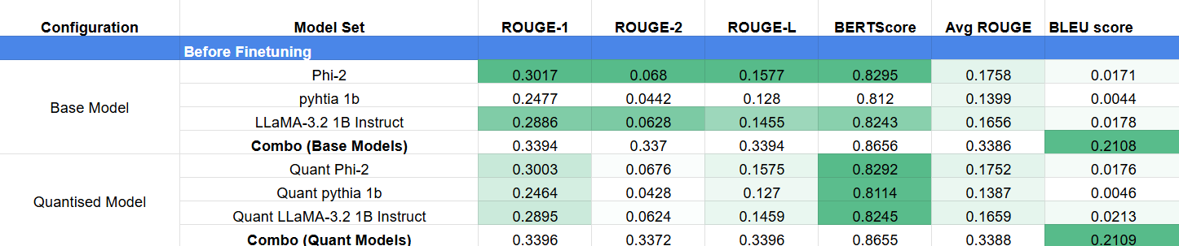

FINDINGS
1)Why are ROUGE and BLEU scores low?
19

Slide 21
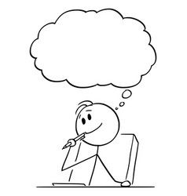
FINDINGS
ROUGE and BLEU focus on exact word matches, not the meaning.
1)Why are ROUGE and BLEU scores low?
20

Slide 22
FINDINGS
ROUGE and BLEU focus on exact word matches, not the meaning.
So ROUGE and BLEU scores will be high even if sentences are not related?
1)Why are ROUGE and BLEU scores low?
21

Slide 23
FINDINGS
ROUGE and BLEU focus on exact word matches, not the meaning.
So ROUGE and BLEU scores will be high even if sentences are not related?
Exactly . Hence those might not be the best metric for us
1)Why are ROUGE and BLEU scores low?
22

Slide 24
SO DOES THIS MEAN BERT SCORE IS A BETTER METRIC IN OUR CASE??
23

Slide 25
SO DOES THIS MEAN BERT SCORE IS A BETTER METRIC IN OUR CASE??
OH YEAHH !! WE’LL SEE HOW
24

Slide 26
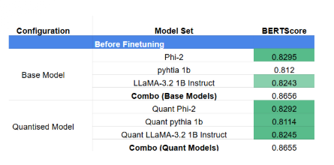
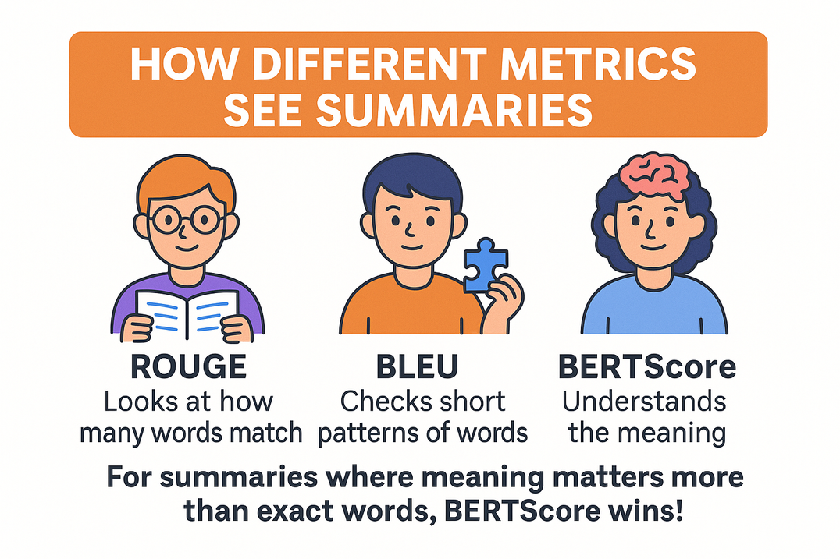
FINDINGS
25

Slide 27
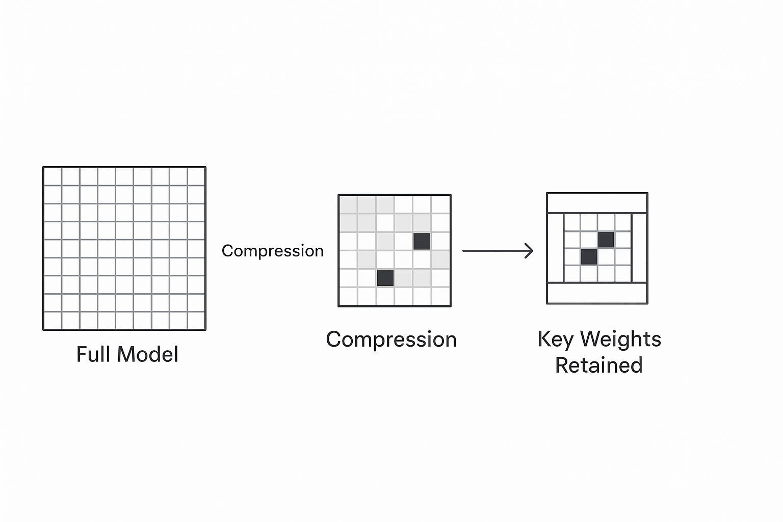
FINDINGS
Why is the score of quantised and base models are similar?
26

Slide 28
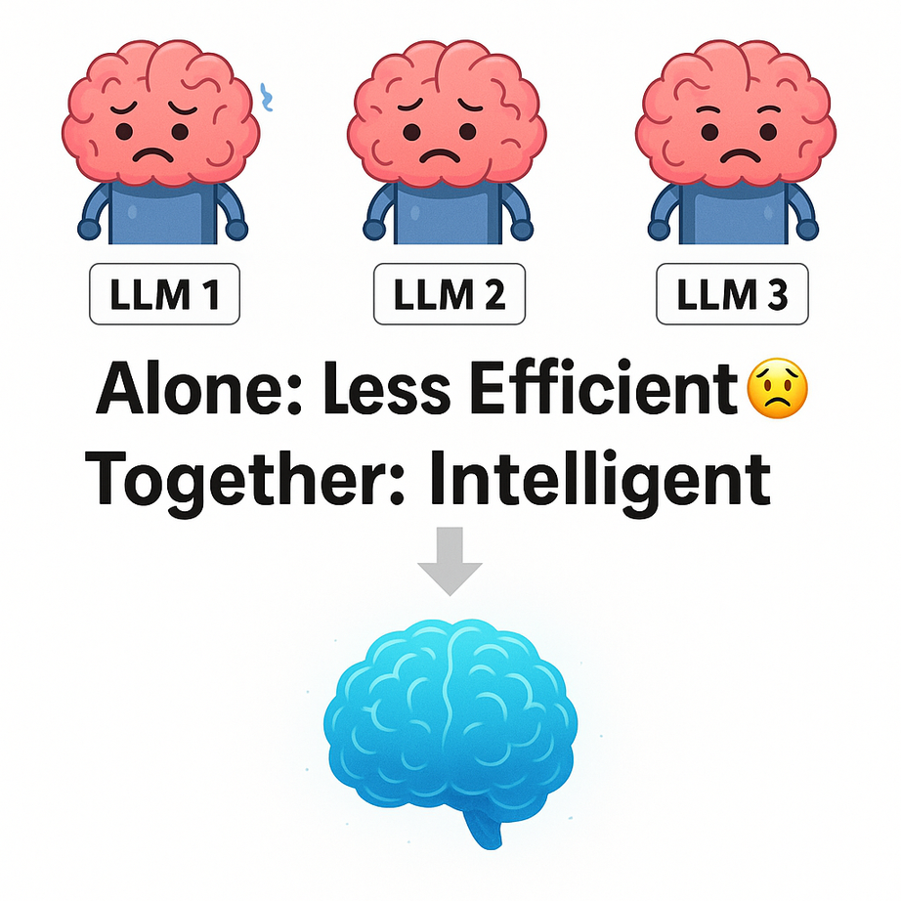
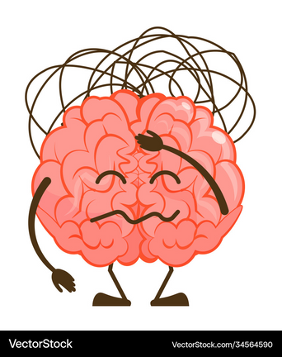
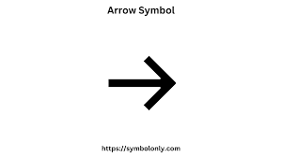
Input
27

Slide 29
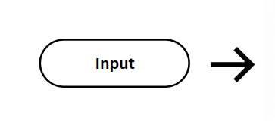



Input
28

Slide 30
MULTI-EXPERT LLM SYSTEM
29

Slide 31
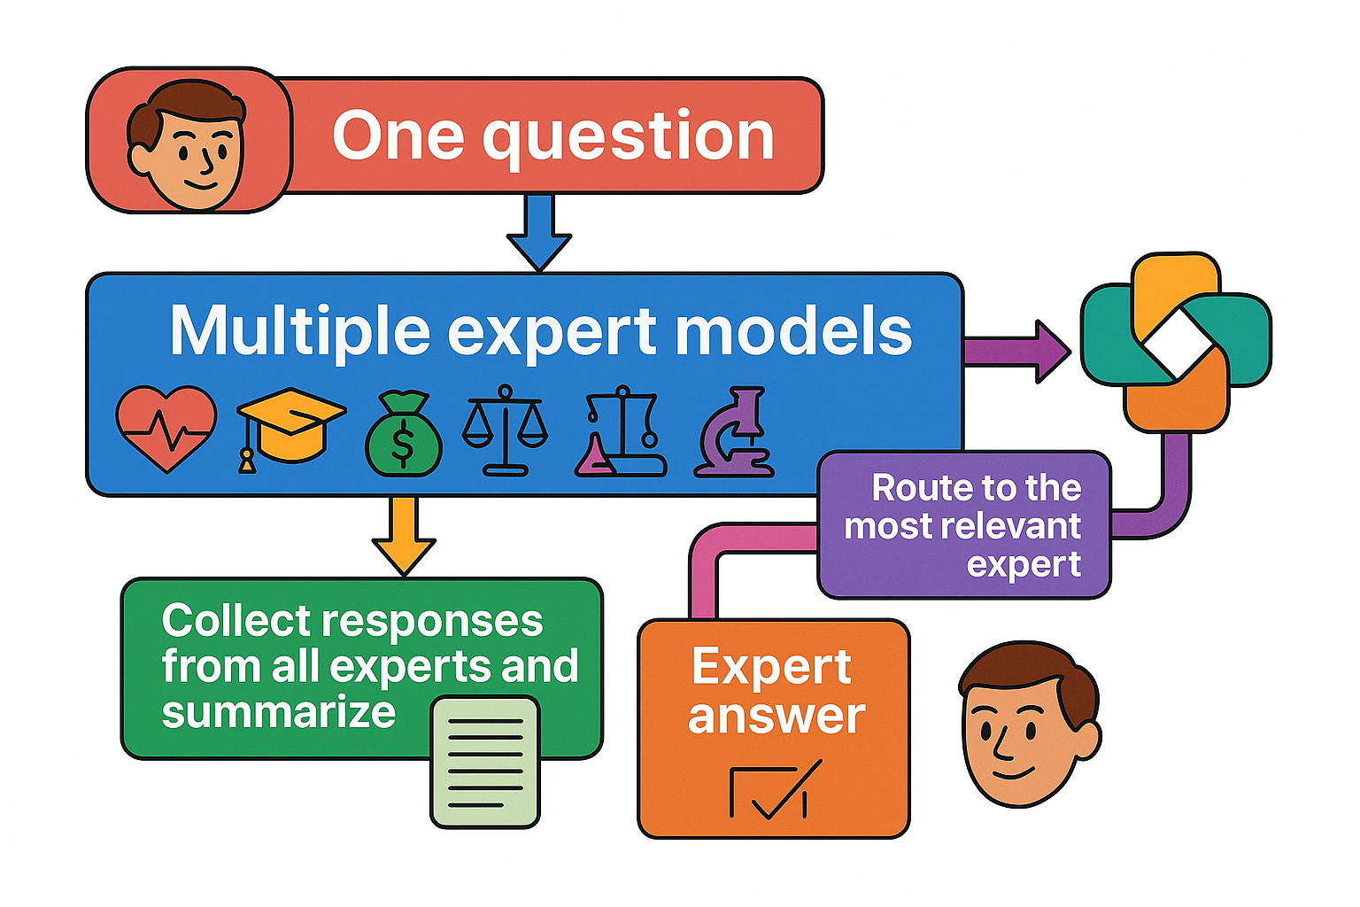
VISION
What are we upto?
30

Slide 32
WHY?
31

Slide 33
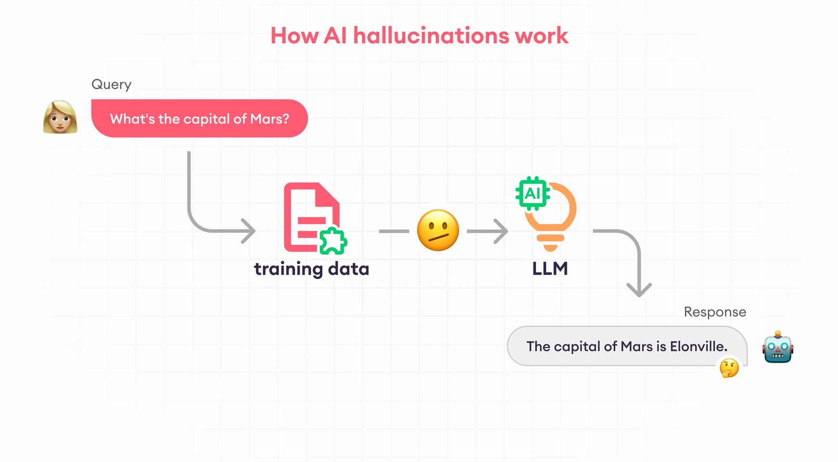
BUT WHY?
Why this Approch?
32

Slide 34
METHODOLOGY
33

Slide 35
Method -1 : Multi-Expert Aggregation
34

Slide 36
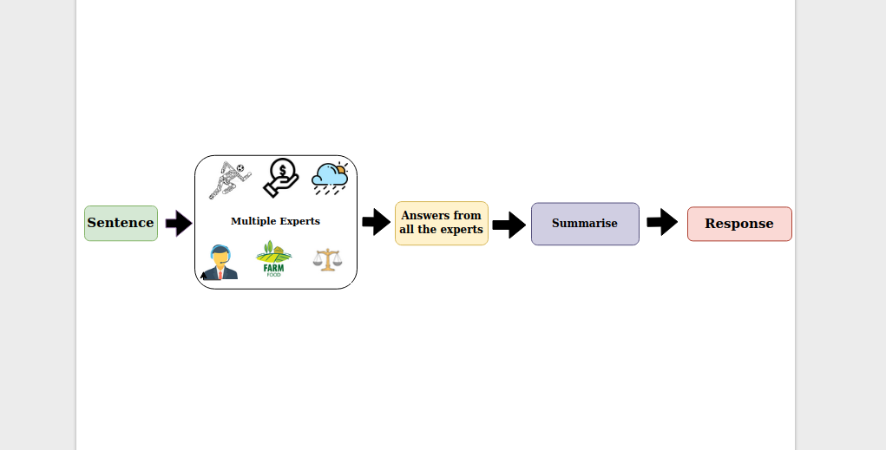
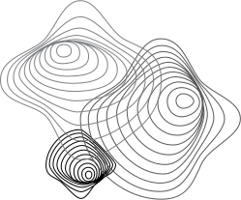
Multi-Expert Aggregation
INPUT
35

Slide 37
Multi-Expert Aggregation
INPUT
Domain Experts
36

Slide 38
Multi-Expert Aggregation
INPUT
Domain Experts
37

Slide 39
Multi-Expert Aggregation
INPUT
Domain Experts
38

Slide 40
Multi-Expert Aggregation
INPUT
Domain Experts
39

Slide 41
Method 2 – Intelligent Expert Routing
40

Slide 42
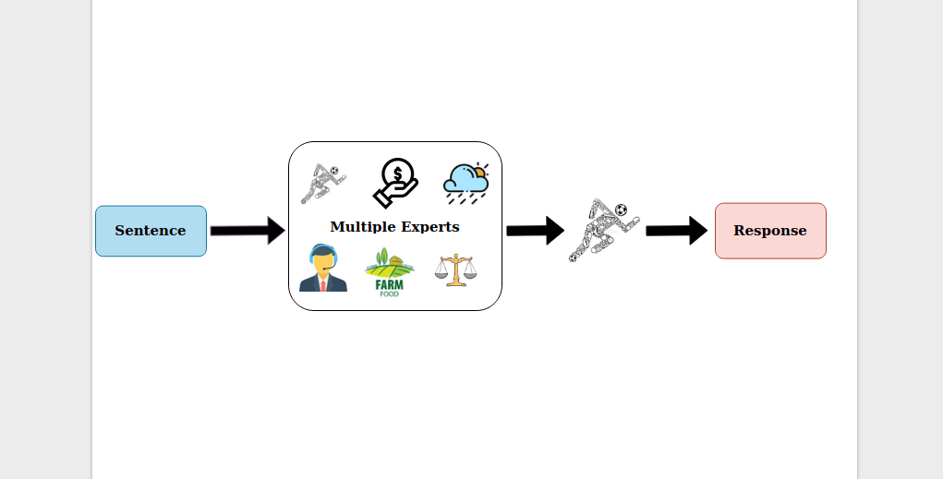
Intelligent Expert Routing
INPUT
41

Slide 43
Intelligent Expert Routing
INPUT
Domain Experts
42

Slide 44
Intelligent Expert Routing
INPUT
Relevant Expert
Domain Experts
43

Slide 45
Intelligent Expert Routing
INPUT
Relevant Expert
Domain Experts
44

Slide 46
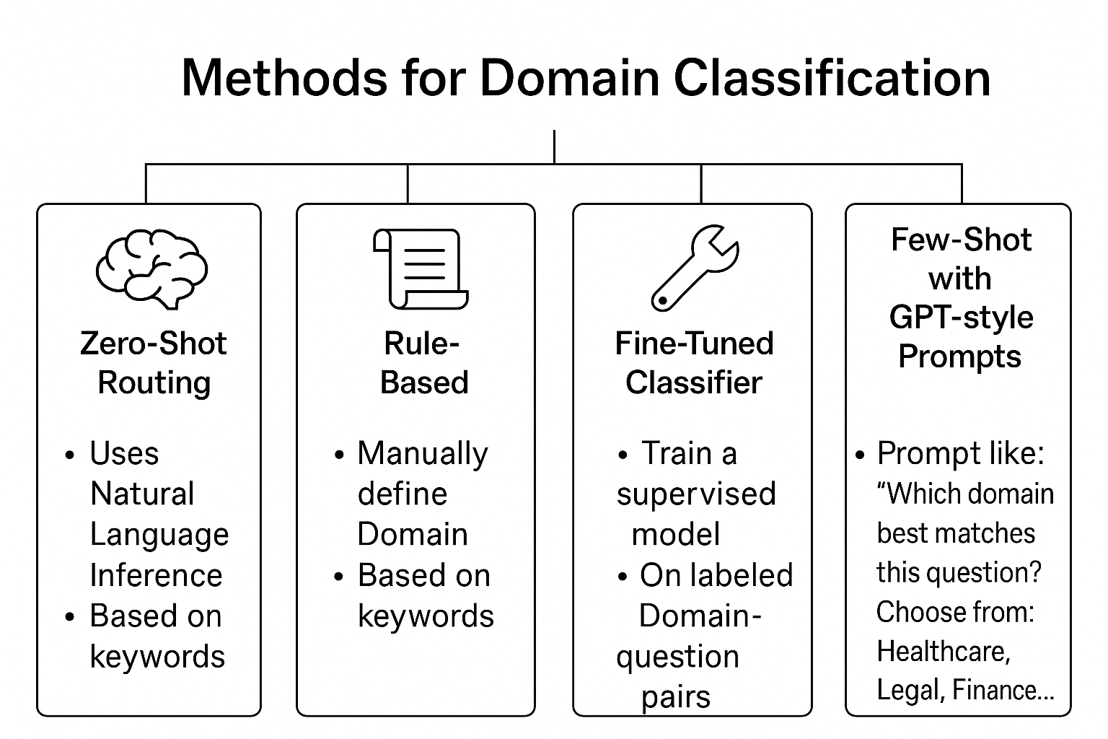
METHODOLOGY
Intelligent Expert Routing
45

Slide 47
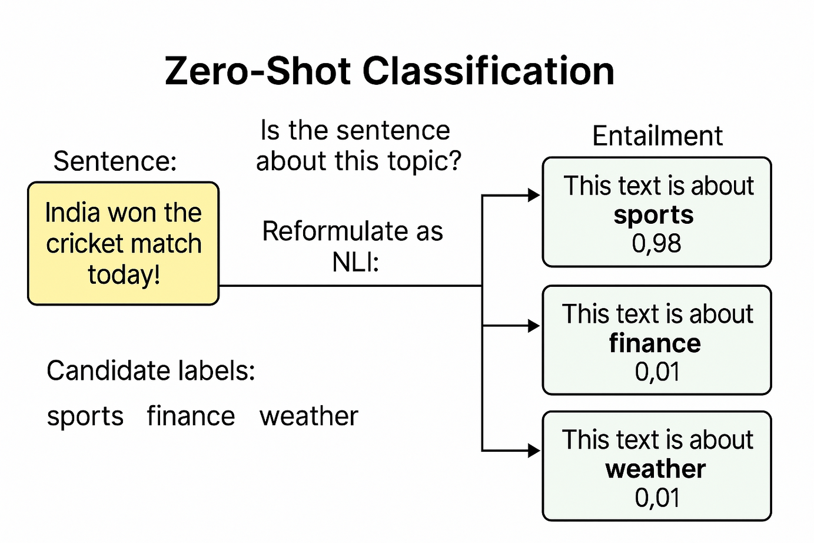
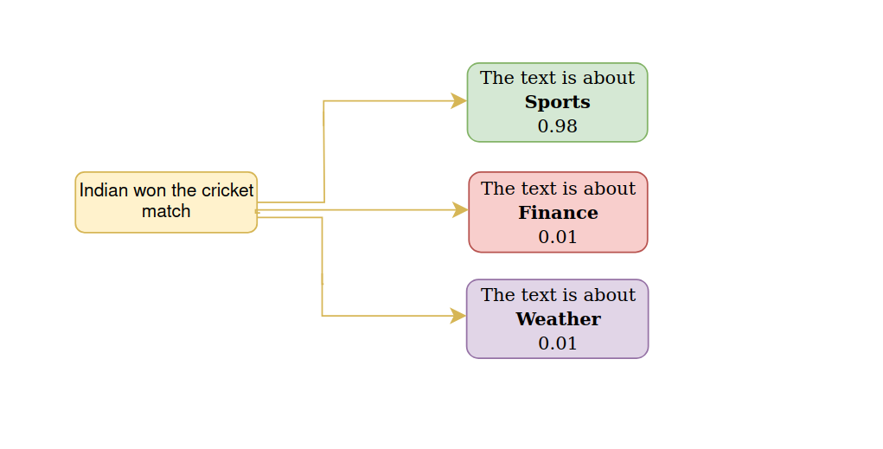
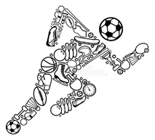
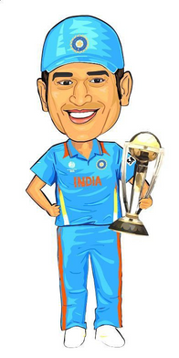


METHODOLOGY
Entailment
Sentence
NLI
Candidate lables:
[Sports ,Finance , Weather]
46

Slide 48
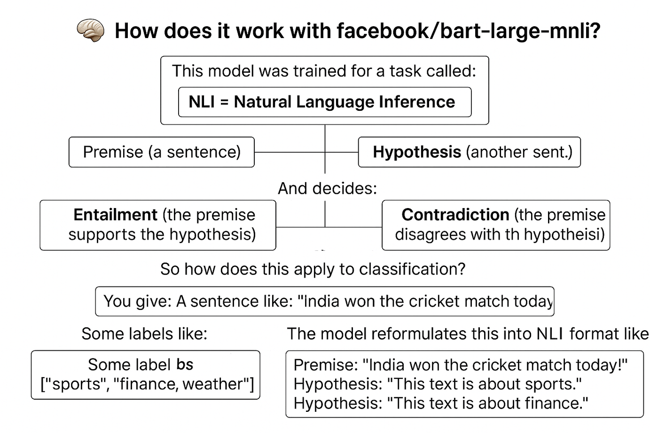
METHODOLOGY
Intelligent Expert Routing - Zero Shot Learning
47

Slide 49






















Some of the Areas and respective LLM Experts
Education
Finance and Insurance
Healthcare and Pharmaceuticals
dmis-lab/biobert-large-cased-v1.1-squad
google/flan-t5-base
Phinance-Phi-3.5-mini-instruct-finance
Government
Customer Service and Field Services
Legal
nlpaueb/legal-bert-base-uncased
GeneZC/MiniChat-1.5-3B
pile-of-law/legalbert-large-1.7M-2
Sales, Marketing, and Advertising
Media and Technical Content
Retail and E-commerce
kingabzpro/llama-3.2-3b-it-Ecommerce-ChatBot
google/flan-t5-large
Qwen/Qwen1.5-1.8B-Chat
Agriculture
Utilities
IT and Technology
Qwen 1.5-1.8B-Chat
48
bigcode/starcoder2-3b
NikkeS/bart-large-lora-finetuned-agriculture-summarization

Slide 50
SUMMARY
We're developing a multi-expert LLM framework for handling text inputs.
The system supports two paths:
Aggregation – All expert models respond → their outputs are summarized.
Expert Selection – Input is sent to the most relevant expert model.
Goals:
1.High-quality output
2.Fast response
3.Context-aware output
49

Slide 51
50

